Slide 1
Muslim Marriage Register Web Application
Project Presentation for Completion of J2EE, Module-08
Submitted To
………………………………………..
Md. Moshahidul Islam
Consultant IDB-BISEW
Submitted By
………………………………………..
Trainee Name: Nazmul Hasan
Trainee id: 1245838
Batch Id: J2EE/APCL-M/38/01

Slide 2
ABOUT
Muslim Marriage Web Application is developed based on All Kind of Paper Work of Bangladesh Muslim Marriage Register & Kazi. In Every Ward/ Union Council lead by a Kazi to sermonize the Marriage of Muslim Couple. Marriage Registration is very much important for various activities in our Life Circle. In Order to digitalize their all paper work and to stop pre-verification of the bride and bridegroom to ensure not a early marriage we first keep an appointment system. By This Kazi will report it. All Activities likely Marriage Registration, Nikahnama, Divorce Form, Divorce Letter, Divorce Certificate and translation service all these feature have in touch to easy their operations. For their Payment system will add the online payment system. To ensure the securities of the data we used real time database data verification and validate.
We build it by JAVA, AngularJS, RestFull Service, Hibernate and My SQL database, HTML5 are used for this project. The interface is very easy looking and easy to use. We hope every kazi and customers will feel free to use the interface.
Thanks

Slide 3
CREATED BY
Nazmul Hasan
Student of
IDB-BISEW IT-Scholarship Project
Round- 38
Subject- J2EE (JAVA PROGRAMMING)
Batch- J2EE/APCL-M/38/01
Date- 02-07-2019

Slide 4
Major Features:
Marriage Register Home
Book Appointment
Appointment Status
Marriage Register Operation Panel
Marriage Certificate
Marriage Registration Form
Nikahnama
Register Admin Log

Slide 5
Features’ Interface

Slide 6
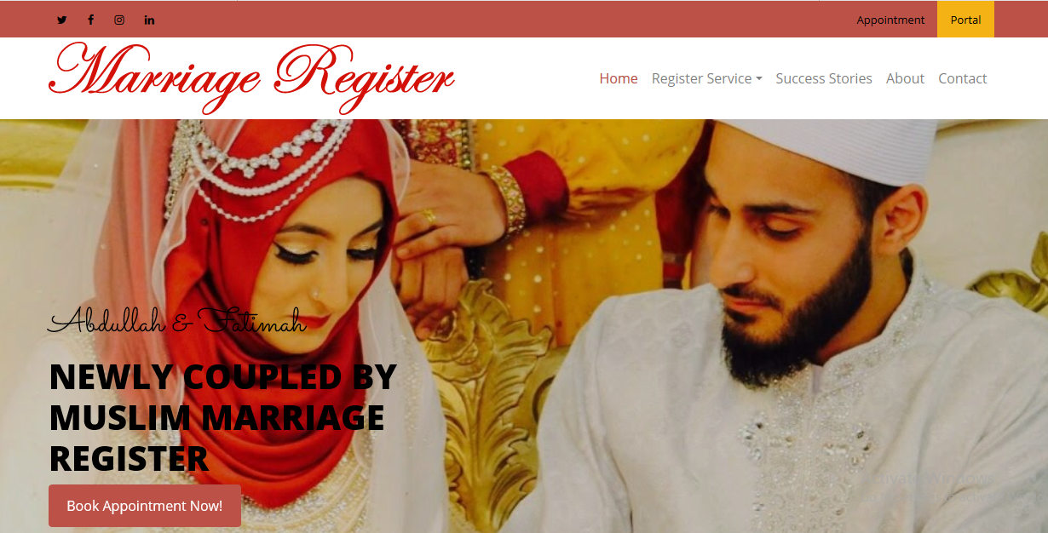
Web Application Home Page

Slide 7
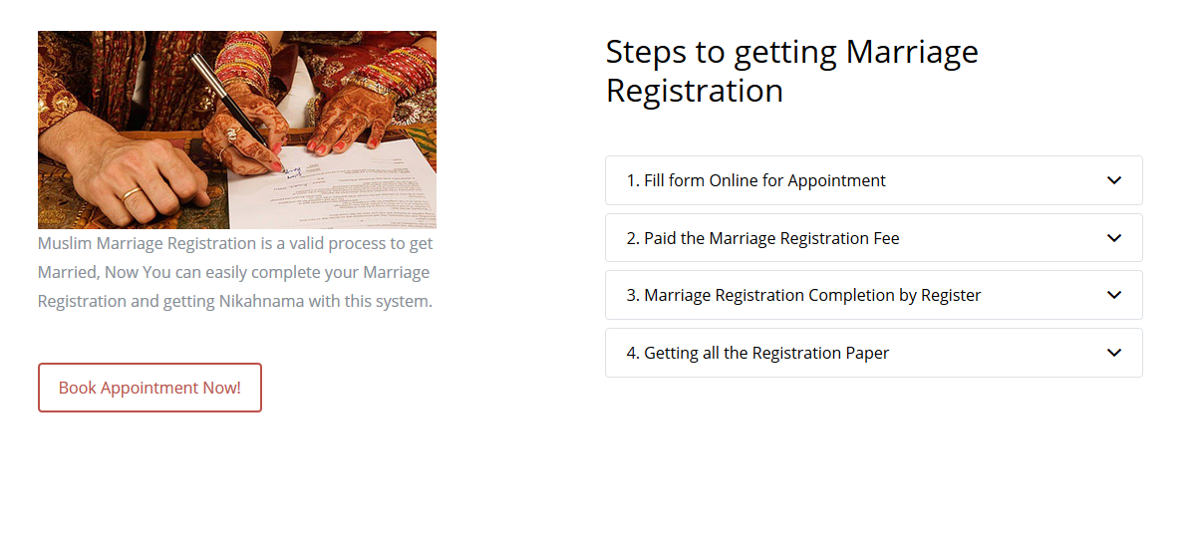
Web Application Home Page

Slide 8
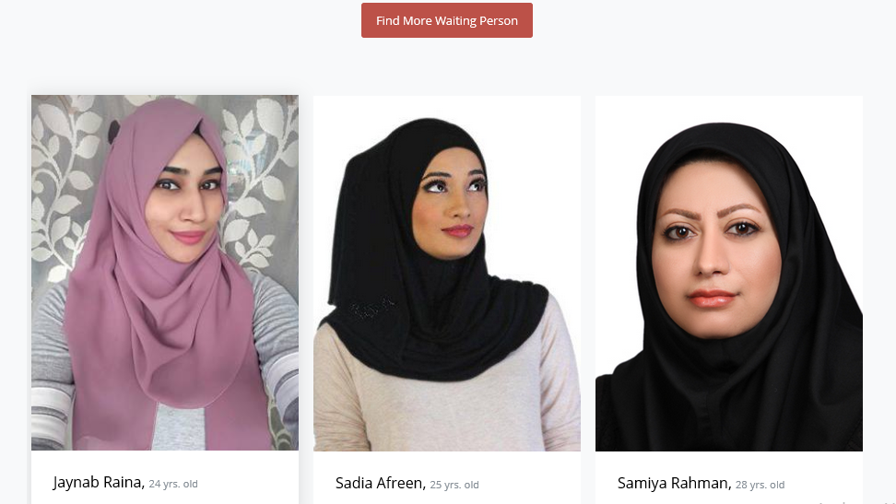
Web Application Home Page

Slide 9
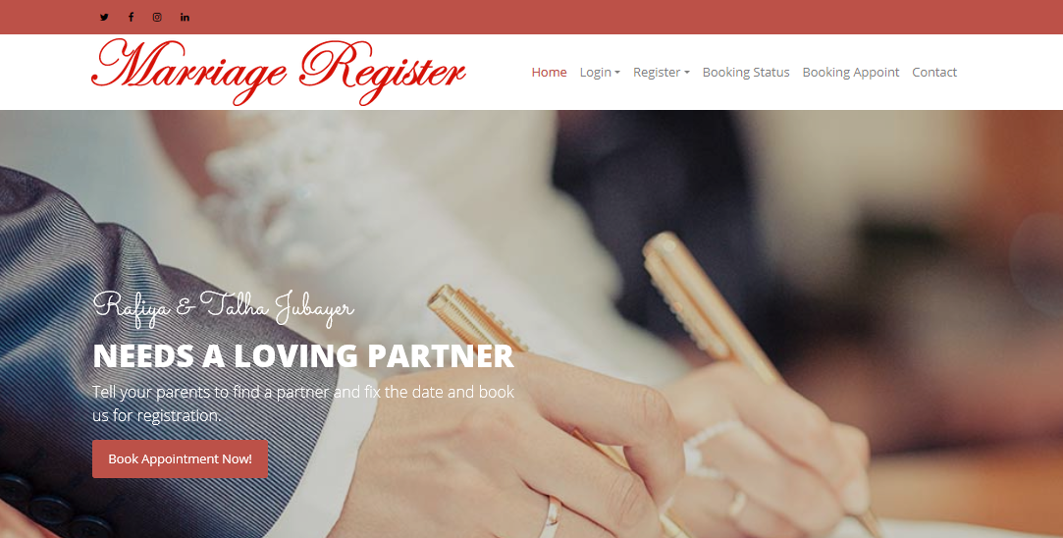
Web Application Home Page

Slide 10
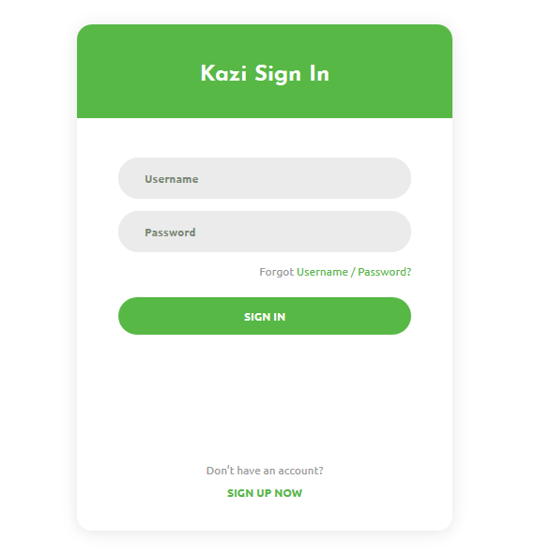
Kazi Login Panel

Slide 11
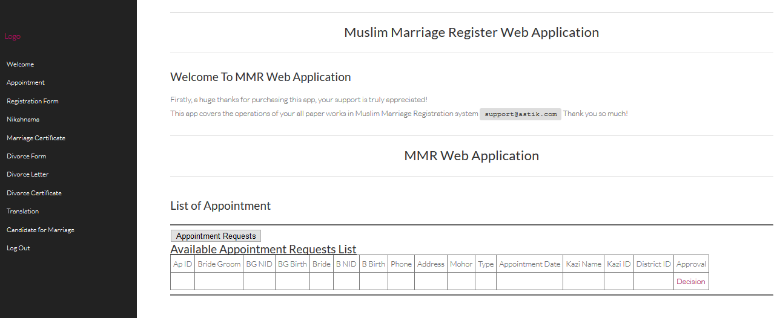
Kazi Panel

Slide 12
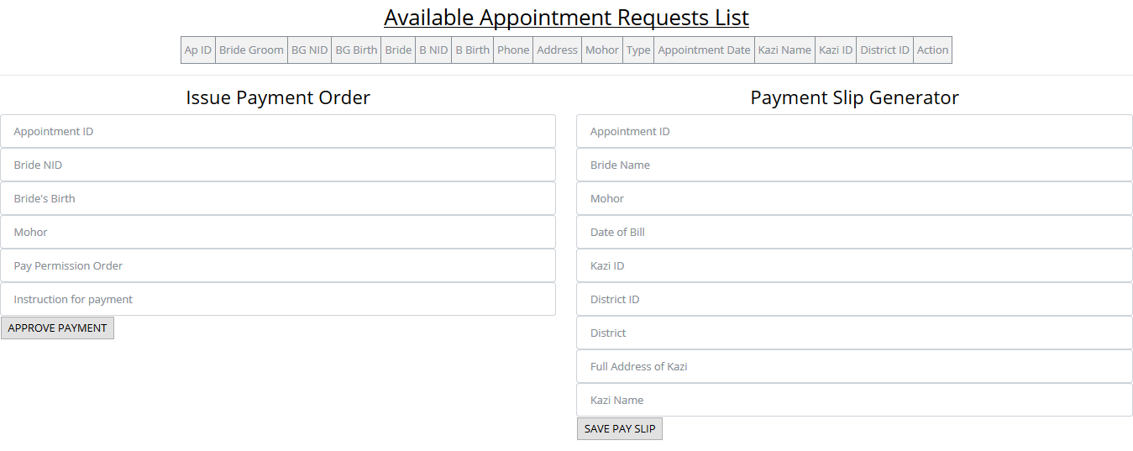
Kazi Operations

Slide 13
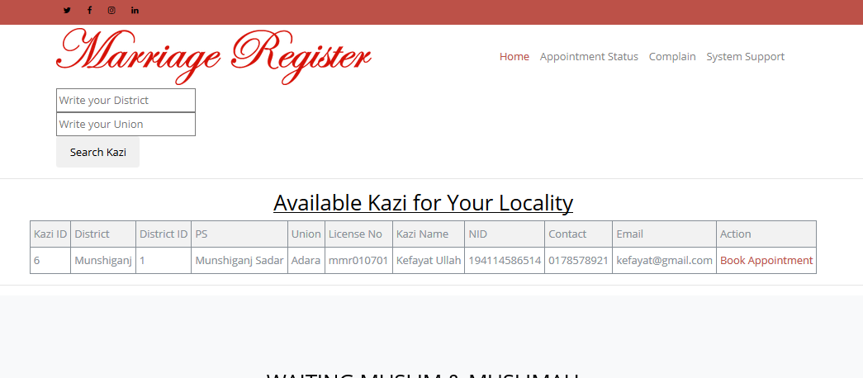
Appointment of Kazi

Slide 14
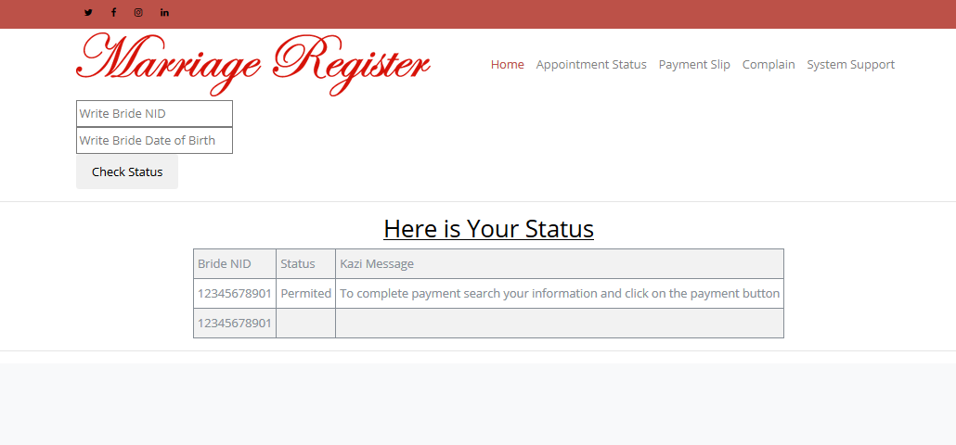
Appointment Status Checking

Slide 15
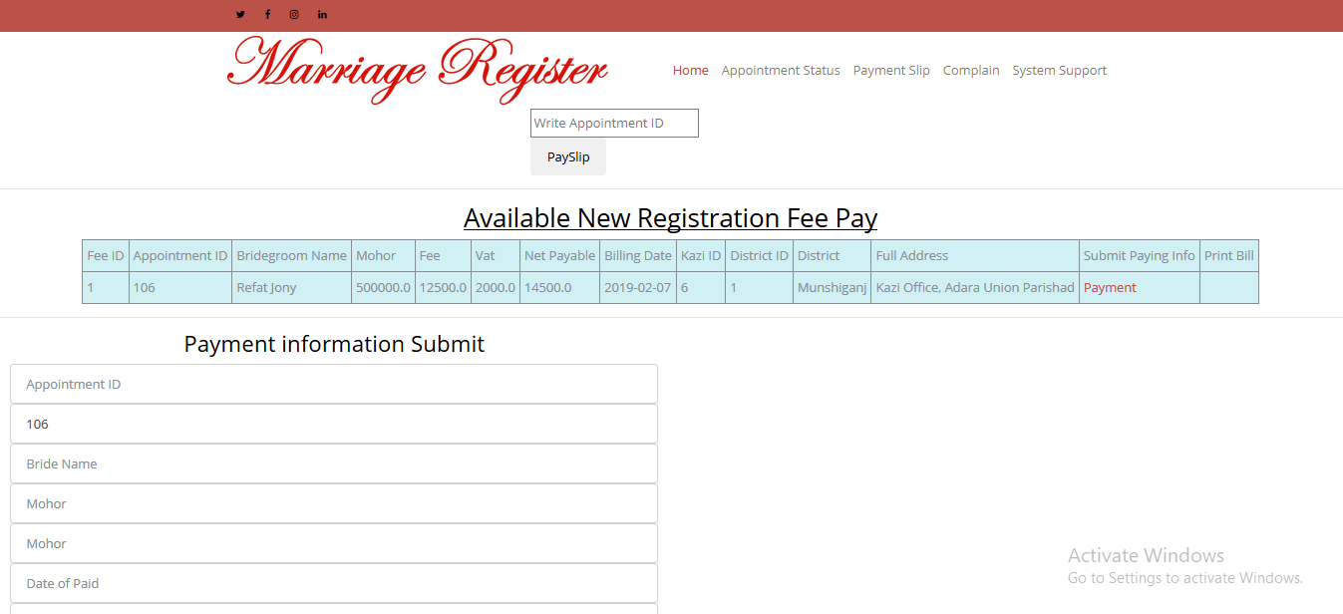
Submiting Payment Info

Slide 16
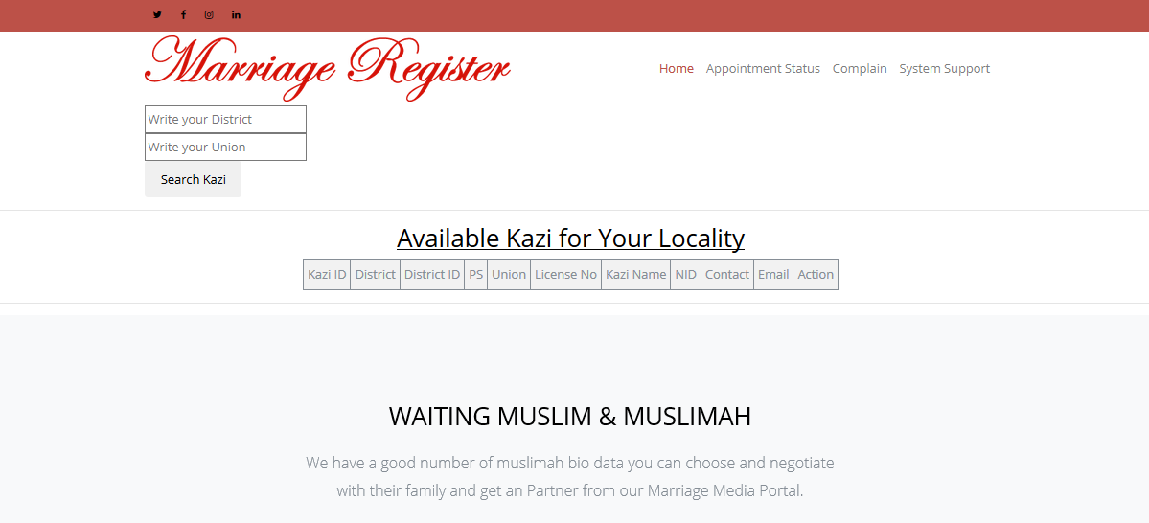
Log In Panel

Slide 17
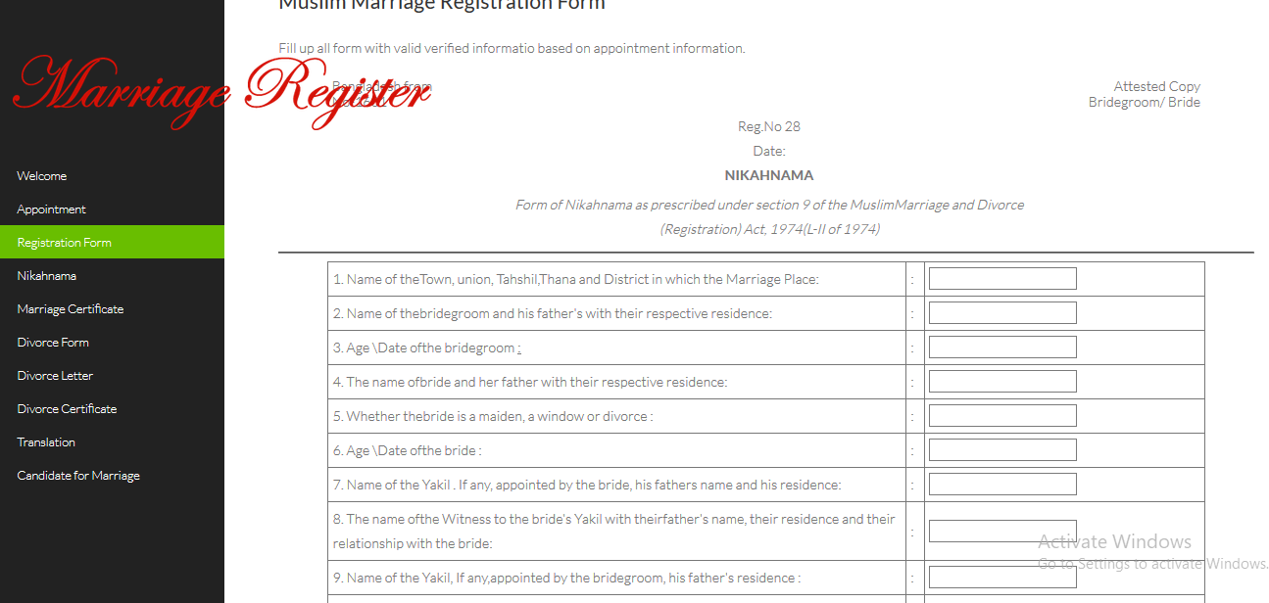
Registration Form

Slide 18
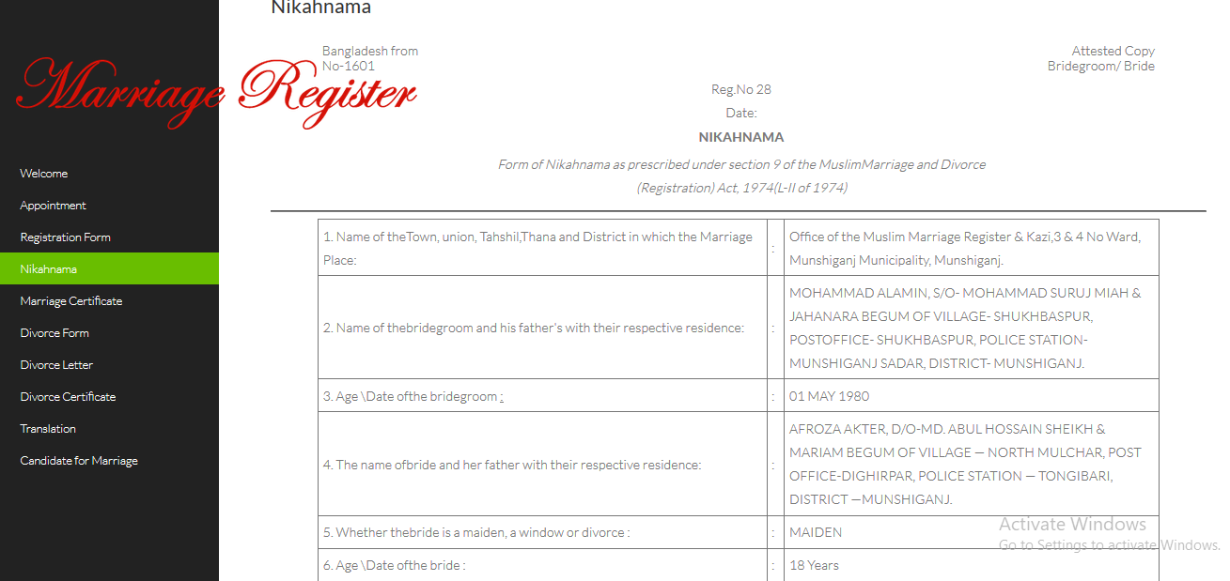
Nikahnama

Slide 19
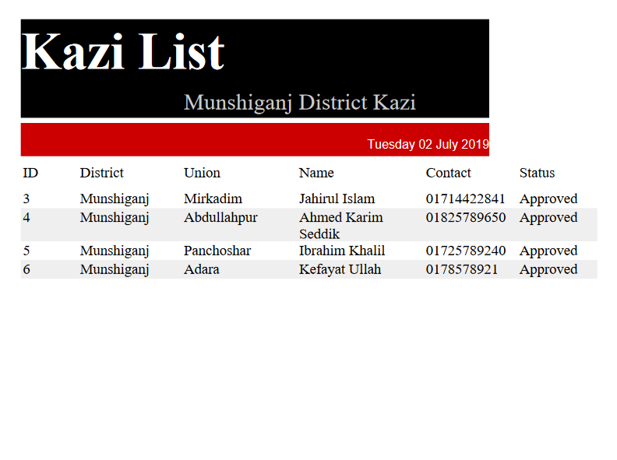
Reporting

Slide 20
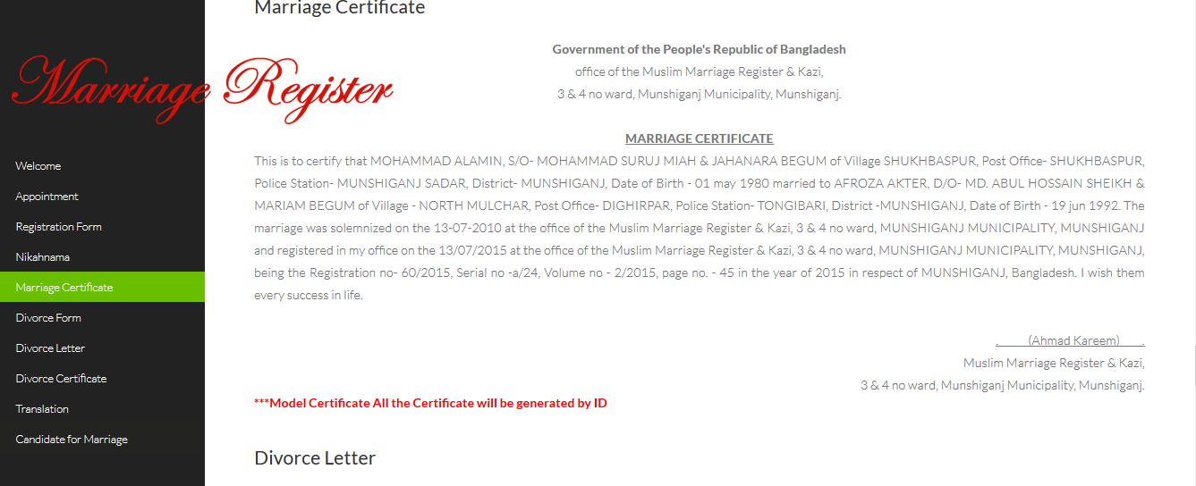
Marriage Certificate

Slide 21
Further Proceedings ..
I will study further on this project modules so that I can understand its marketing strategy and business logical and real time response of the operations handler in order to improve the overall automation system with full securities and data validation.

Slide 22
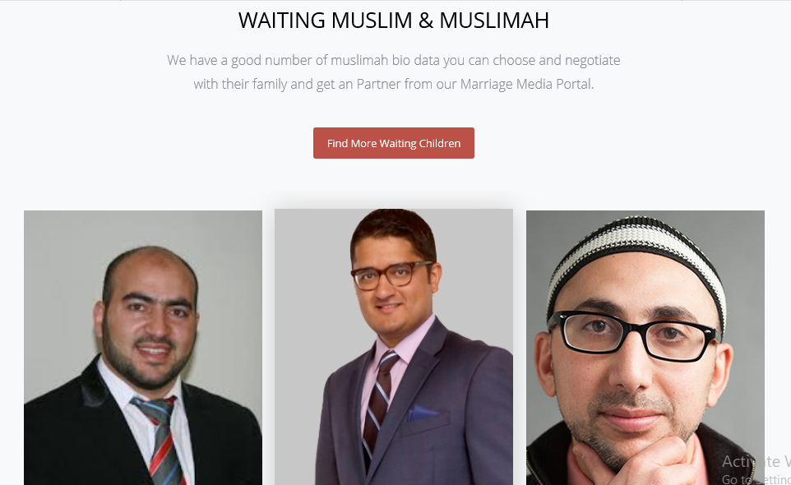
Marriage Media

Slide 23
Using Technology & Framework
JAVA
Jdk
NetBeans IDE
Oracle
MySQL
MySQL Workbench
Hibernate
Spring MVC
Bootstrap

Slide 24
Thank you

